Slide 1
Quantifying Cement Systems using Image Analysis
Colin Leung
Cement Chemistry Team
December 13th, 2011

Slide 2
Contents
Introduction
Purpose of Investigation
Sample Information and Preparation Procedures
Image Analysis Algorithms:
Particle-Based Grey Level Segmentation
Particle-Based Morphological Segmentation
Particle-Based EDS Data Corroboration
Conclusion

Slide 3
Introduction
Want to analyze mass percentages and particle size distributions (milling characteristics) of the phases that make up commercial cement, which heavily influence its physicochemical characteristics

Slide 4
Potential Applications
Basis for additional research that depends on mass percentages or particle size distributions (i.e. hydration product, clinker size research):
Investigate competing cement formulas
Improve quality control for cement manufacturing processes such as milling

Slide 5
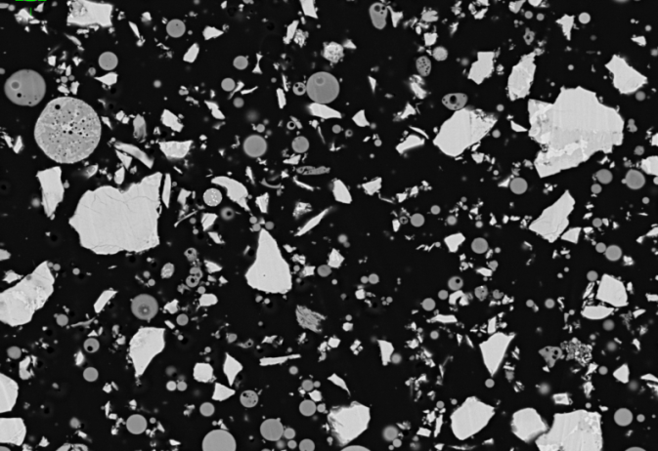
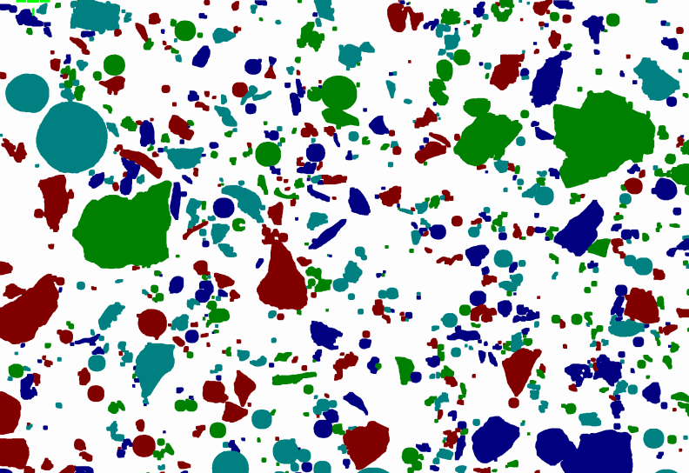
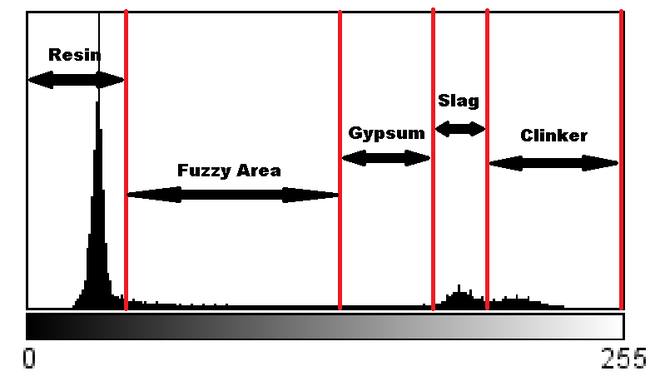
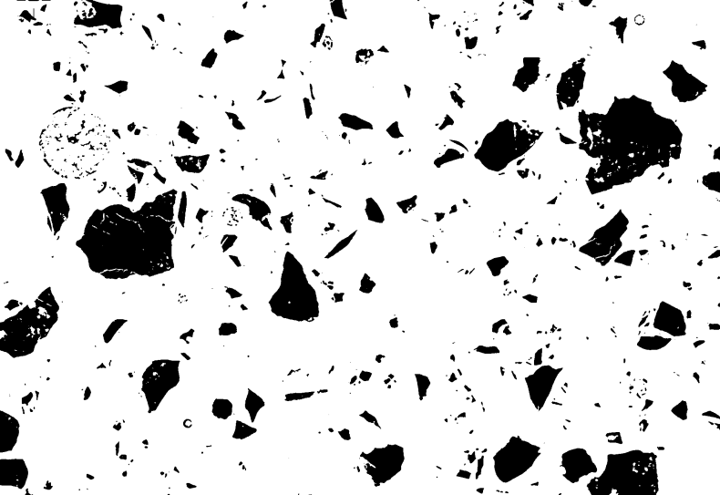
EDS Segmentation
Simple Grey Level Segmentation
EDS
SEM
BEI
Class | Average Grey Level | Circularity | Chemical Composition
 |  |  | Si | Al | Ca | Fe
A | … | … | … | … | … | …
B | … | … | … | … | … | …
C | … | … | … | … | … | …
… | … | … | … | … | … | …

Slide 6
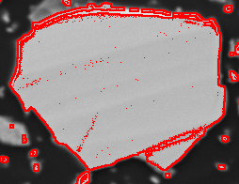
Simple Grey Level Segmentation Problems
Cross-section polishing artefacts
Electro-magnetic distortion

Slide 7
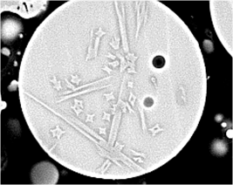
EDS Segmentation Problems
Large range of chemical compositions in phases such as fly ash
Many kinds of crystal minerals,
each with their own chemical
composition
Difficult to segment phases if fly ash has similar chemical composition to slag or clinker
Cannot accurately measure particles smaller than 1 micrometer

Slide 8
Purpose of Investigation
Simple Grey Level Segmentation and EDS Segmentation are not accurate enough, can only implement simple segmentation classes based on pre-calculated information
Create new image analysis algorithms to segment the phases using more complex information and methods:
Particle-Based Grey Level Method
Particle-Based Morphological Method
Particle-Based EDS Data Corroboration
(New capability)

Slide 9
Sample Information and Preparation Procedures
Particle-Based Grey Level Segmentation:
Clinker (57% mass) + Gypsum (3) + 4500 cm²/g Blaine Slag (40)
Particle-Based Morphology Segmentation:
Clinker (70) + Japanese Fly Ash (30)
Preparation Procedures:
Immersed in resin medium
Polished using cross-section polishing machine
Carbon covered for SEM-EDS measurements
At least 10 BEI images taken at 500X magnification for image analysis

Slide 10
I. Particle-Based Grey Level Segmentation

Slide 11
Particle-Based Grey Level Segmentation Principle
Images should be segmented by grey level in terms of particles, not pixels

Slide 12
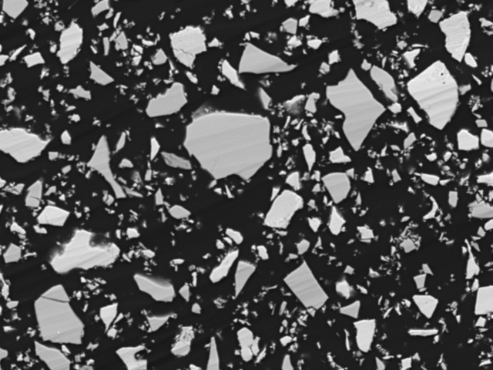
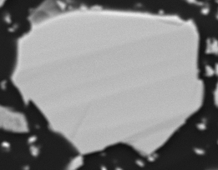
Raw Image
Particle Extraction
Pixel Classification
Particle Classification
Phase Images
Back-scattered Electron Image of Clinker and Slag 4500 Sample with Enlarged Particle

Slide 13
Raw Image
Particle Extraction
Pixel Classification
Particle Classification
Phase Images
Number of Pixels
Grey Level Value
Histogram of Sample Image with Phase Grey Level Thresholds

Slide 14
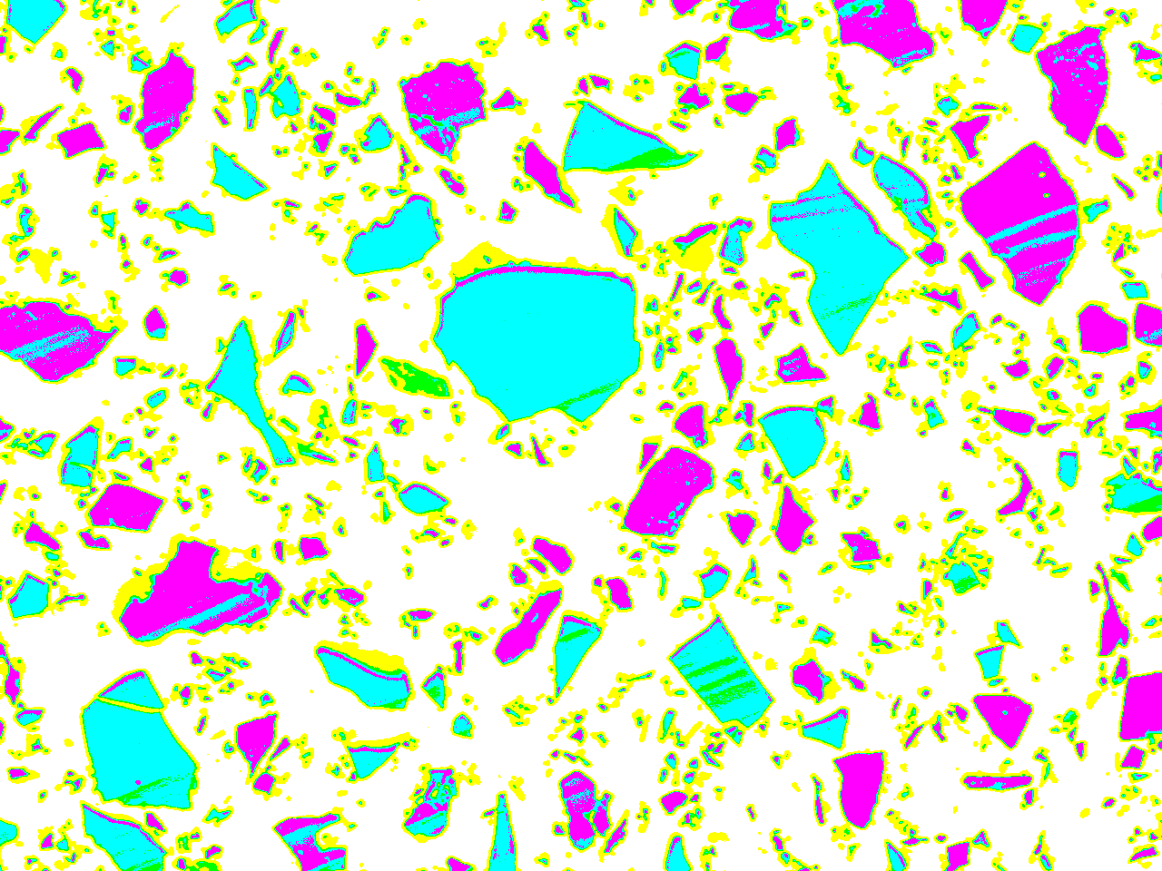

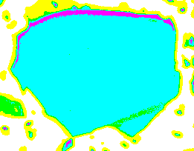



Raw Image
Particle Extraction
Pixel Classification
Particle Classification
Phase Images
Clinker
Slag
Gypsum
Fuzzy Area
Resin
Grey Level Segmented Sample Image with Enlarged Particle

Slide 15

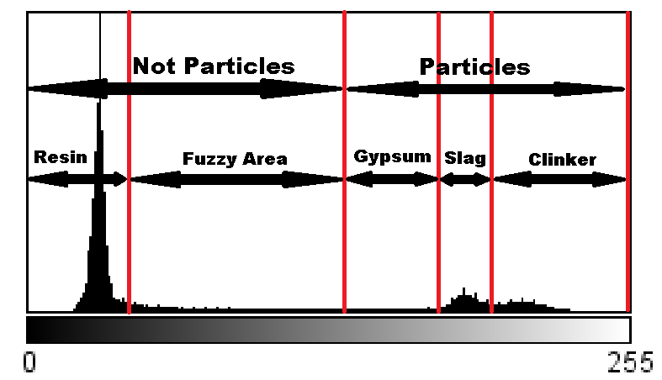
Raw Image
Particle Extraction
Pixel Classification
Particle Classification
Phase Images
Number of Pixels
Grey Level Value
Histogram of Sample Image with the Particle Grey Level Threshold

Slide 16
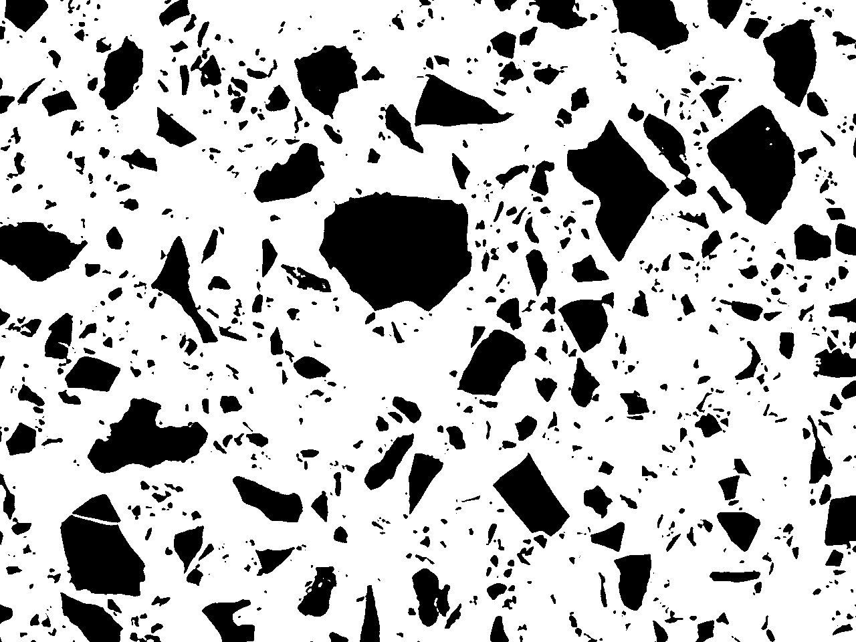

Raw Image
Particle Extraction
Pixel Classification
Particle Classification
Phase Images
Particle Segmented Sample Image with Enlarged Particle

Slide 17

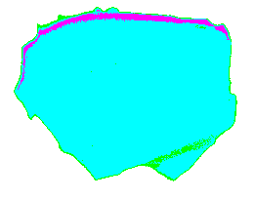
Raw Image
Particle Extraction
Pixel Classification
Particle Classification
Phase Images
Clinker
Slag
Gypsum
Fuzzy Area
Resin
Phase | Area Percentage
Slag | 92.34%
Clinker | 3.83%
Gypsum | 3.83%
Particle is classified as the phase with the highest area percentage.
So this particle is categorized as slag.

Slide 18
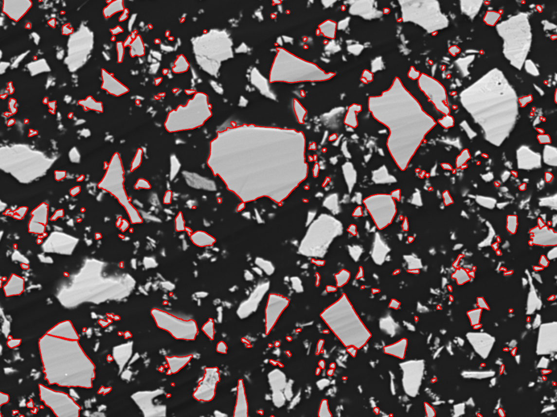
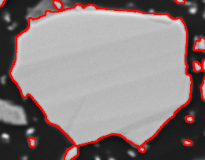
Raw Image
Particle Extraction
Pixel Classification
Particle Classification
Phase Images
Sample Image with Enlarged Particle (slag outlined in red)

Slide 19


Raw Image
Particle Extraction
Pixel Classification
Particle Classification
Phase Images
Slag Only Sample Image with Enlarged Particle

Slide 22
II. Particle-Based Morphological Segmentation

Slide 23
Particle-Based Morphological Segmentation Principle
Particles can separated in terms of morphology, not just grey level

Slide 24
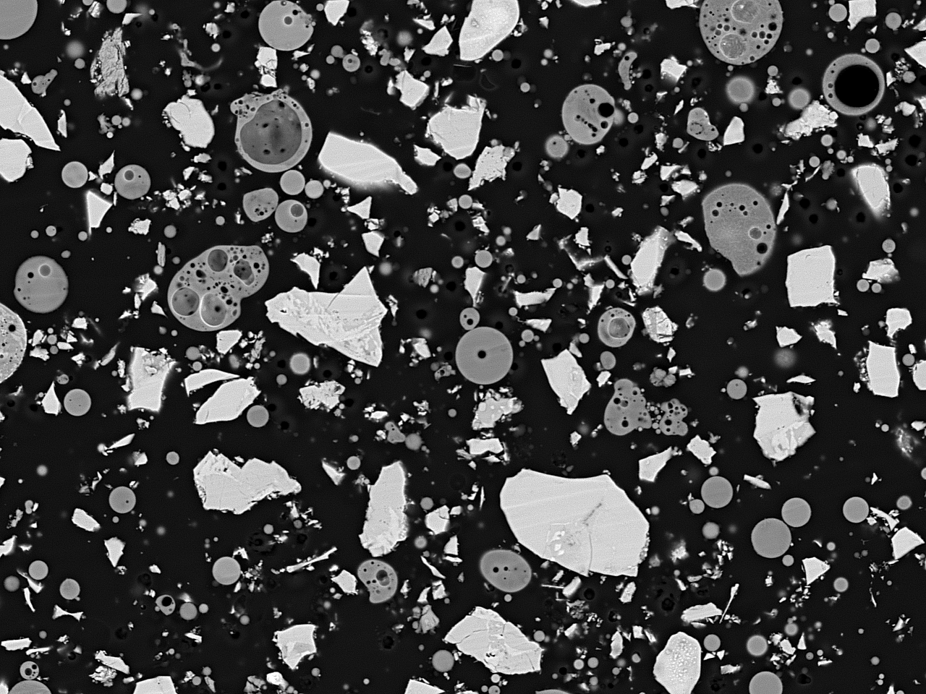
Particle Circularity Filtering
Hole Circularity Filtering
Raw Image
Phase Images
Particle Extraction
Back-scattered Electron Image of Clinker and Fly Ash Sample

Slide 25

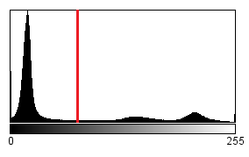
Particle Circularity Filtering
Hole Circularity Filtering
Raw Image
Phase Images
Particle Extraction
Resin
Particle
Number of Pixels
Grey Level Value
Histogram of Sample Image with the Particle Grey Level Threshold

Slide 26
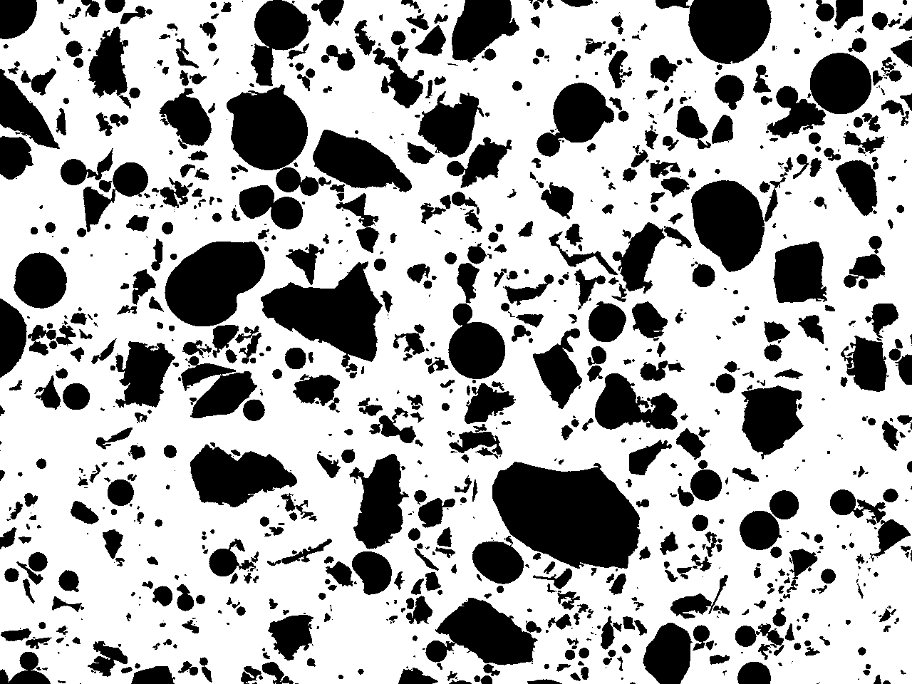
Particle Circularity Filtering
Hole Circularity Filtering
Raw Image
Phase Images
Particle Extraction
Particle Segmented Sample Image

Slide 27
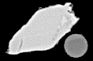

Particle Circularity Filtering
Hole Circularity Filtering
Raw Image
Phase Images
Particle Extraction
Circularity = 0.951
Circularity = 0.631
Phase | Average Circularity
Clinker | 0.633
Fly Ash | 0.947

Slide 28
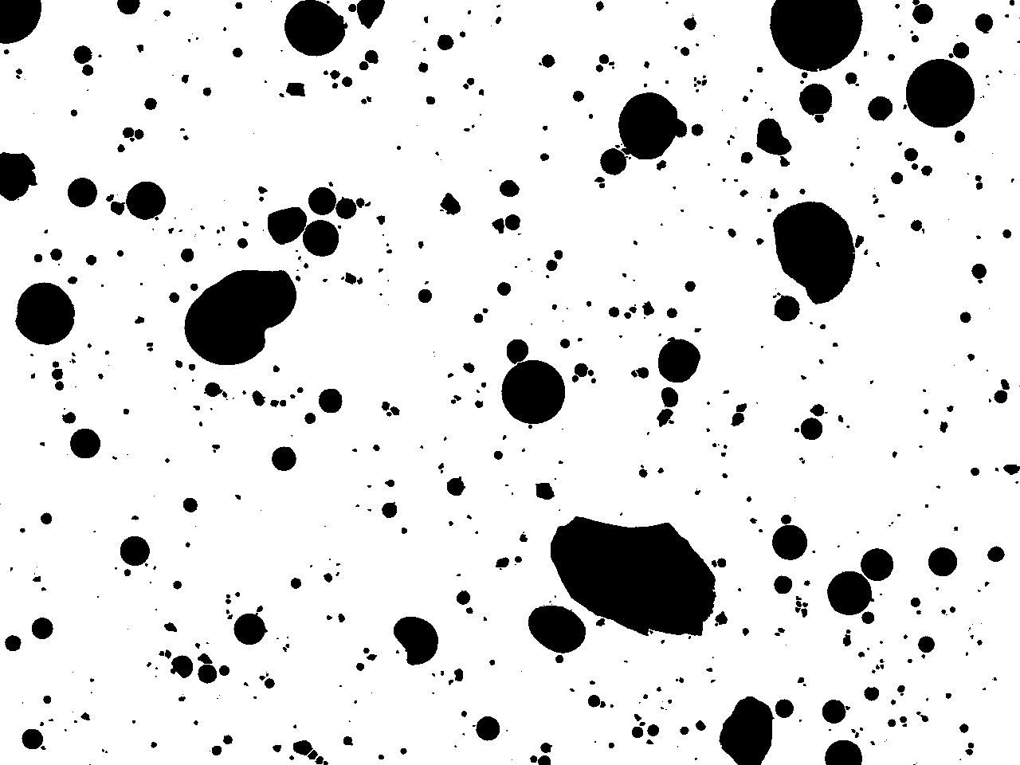
Particle Circularity Filtering
Hole Circularity Filtering
Raw Image
Phase Images
Particle Extraction
Circularity Filtered Sample Image

Slide 29
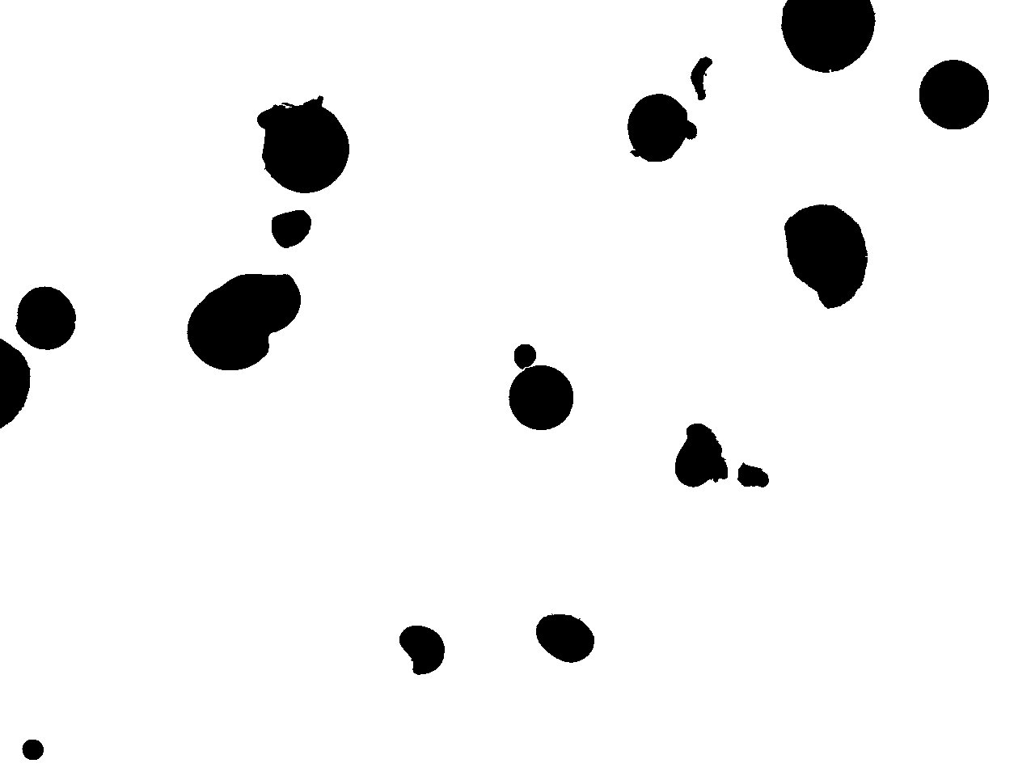



Particle Circularity Filtering
Hole Circularity Filtering
Raw Image
Phase Images
Particle Extraction
Circularity = 0.433
Circularity = 0.960
Hole Circularity Filtered Sample Image with Enlarged Particle Image

Slide 30
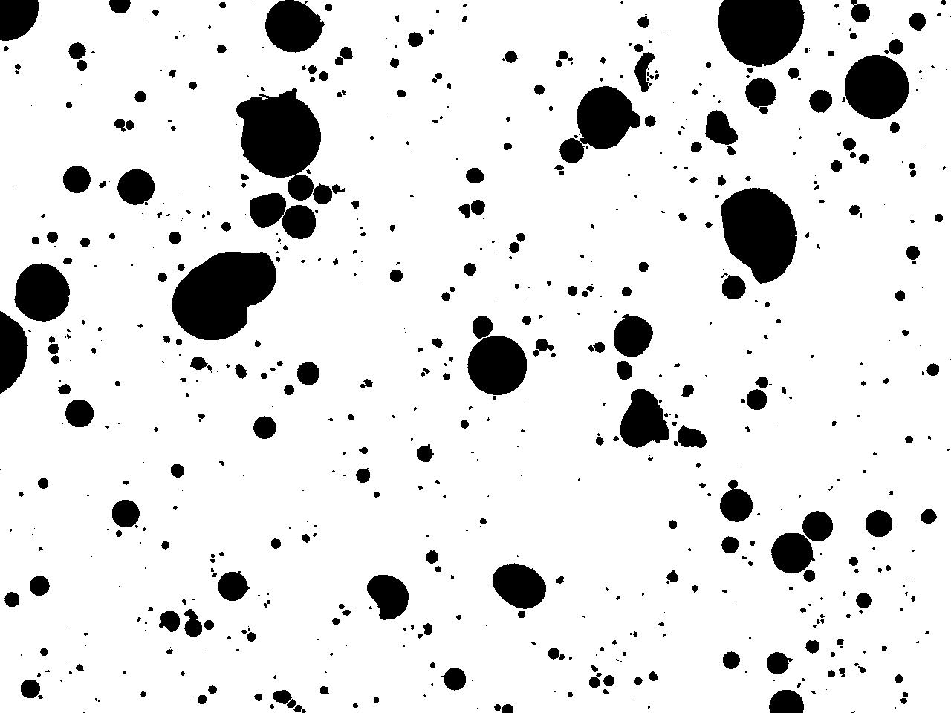
Particle Circularity Filtering
Hole Circularity Filtering
Raw Image
Phase Images
Particle Extraction
Fly Ash Phase Image

Slide 31
Accurate results for clinker + Japanese fly ash sample
Other samples have yet to be investigated

Slide 32
III. Particle-Based EDS Data Corroboration
(Part I + Part II + EDS)

Slide 33
New Capabilities
Can compare both image analysis and EDS data (i.e. average grey level and chemical composition) in a single algorithm, which enables us to achieve more accurate results
+
EDS
Image Analysis

Slide 35
Conclusion
Can now measure complex features of particles such as hole circularity or particle area percentages
Particle-based grey level and morphological segmentation show great improvements in accuracy when measuring phase mass percentages and particle size distributions
Accuracy and efficiency can be improved by combining both image analysis and EDS data

Slide 36
Image Analysis Issues
Accurate particle extraction
Minimum particle sample size for accurate results
Optimal image magnification

Slide 37

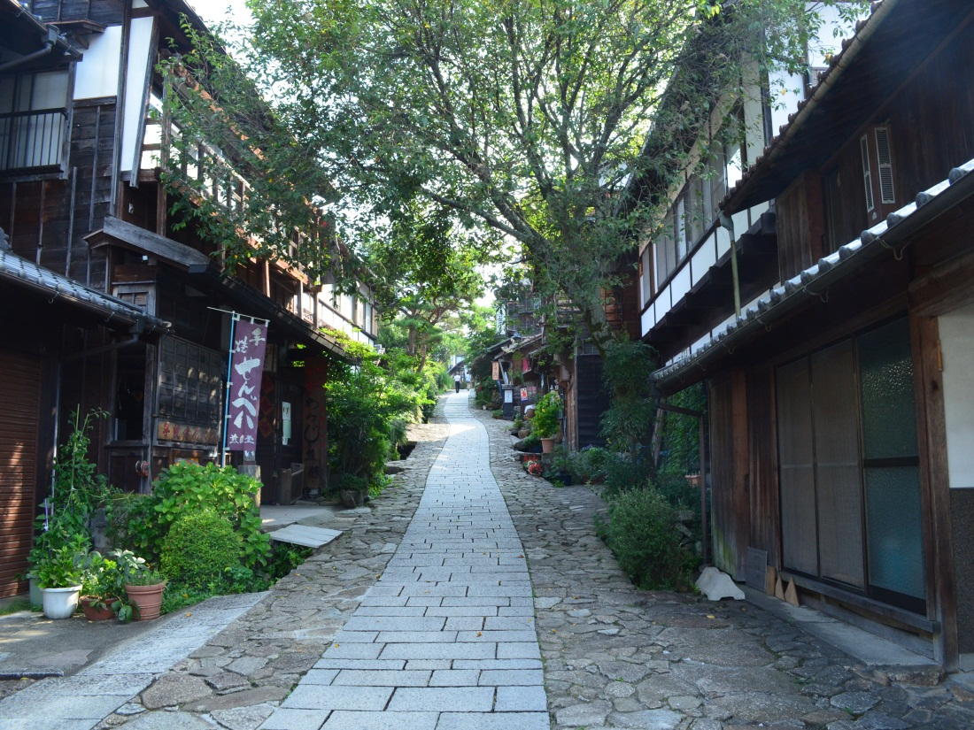
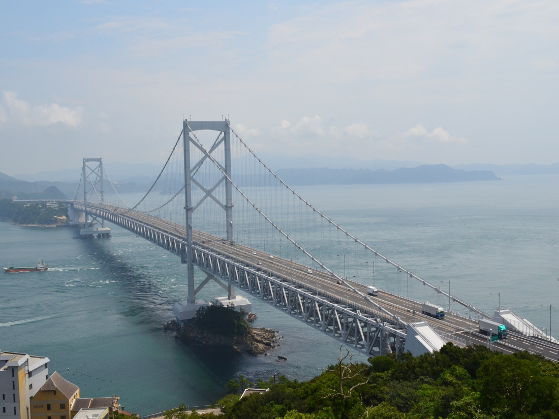


Slide 38
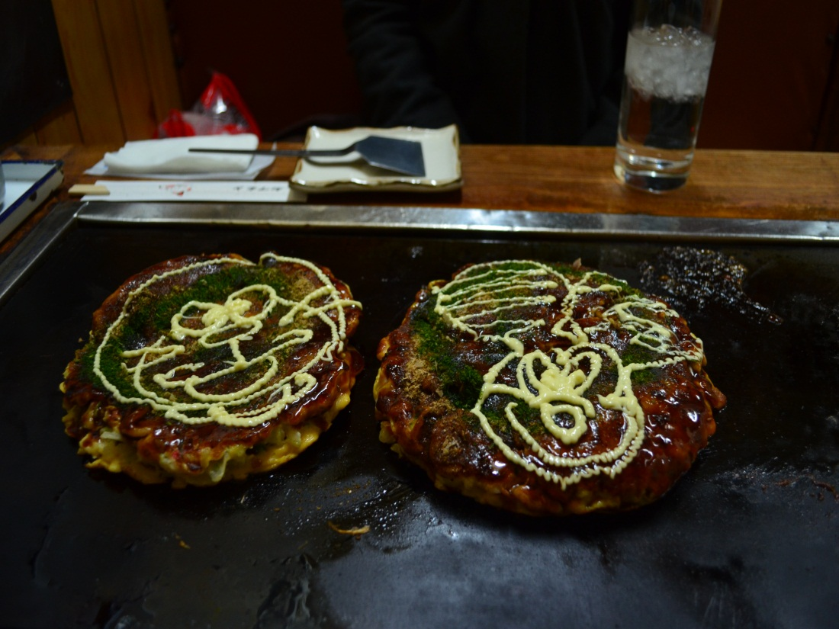




Slide 39
FIN

Slide 40
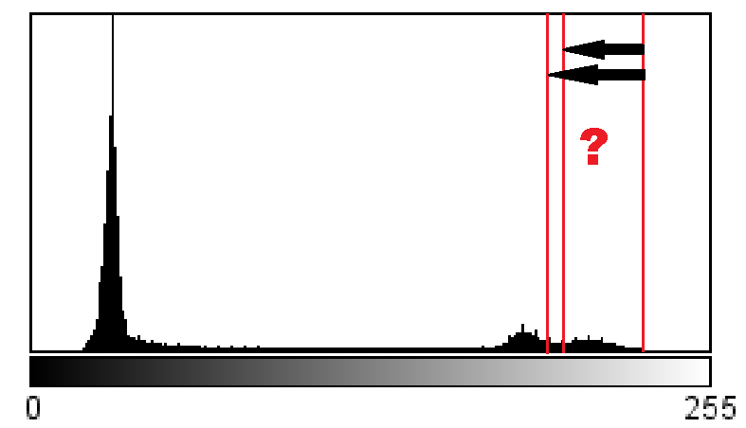
Area Categorization
1. Number of categories/phases
(clinker, slag, gypsum, fuzzy area, resin = 5)
2. Grey level threshold values
Notes:
40

Slide 41
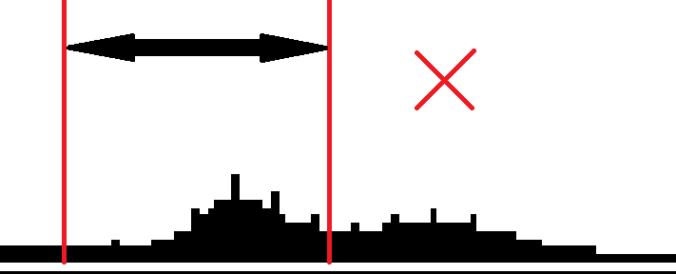
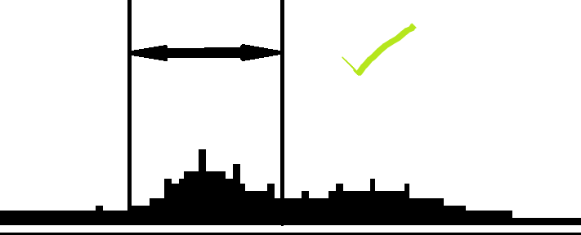
Grey Level Threshold Determination
Two Guidelines
Enclose Visible Histogram Features
Notes:
41

Slide 42
Grey Level Threshold Determination
2. Maintain Particle Integrity
Notes:
42

Slide 43
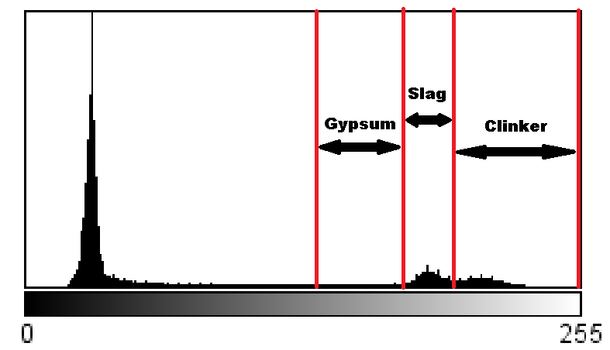
Naïve Grey Level Segmentation
Clinker + Slag System SEM-BSE Image
Image Grey Level Histogram
Notes:
43

Slide 44
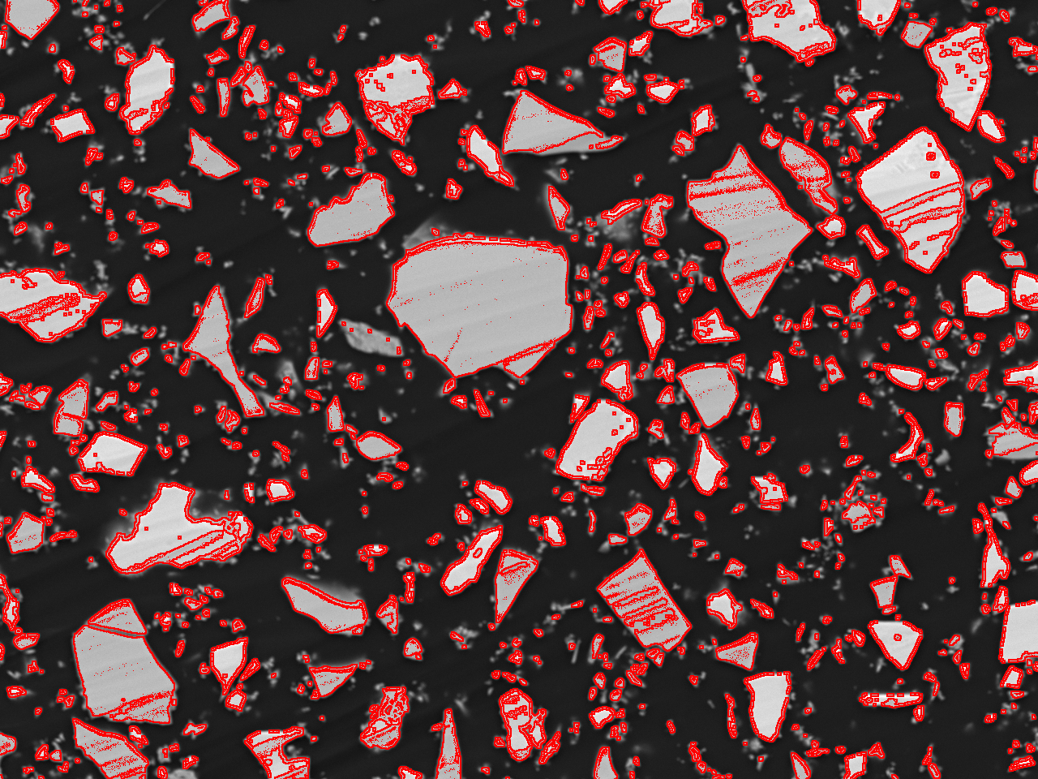
Naïve Grey Level Segmentation
Slag Areas Outlined in Red
Notes:
44

Slide 45
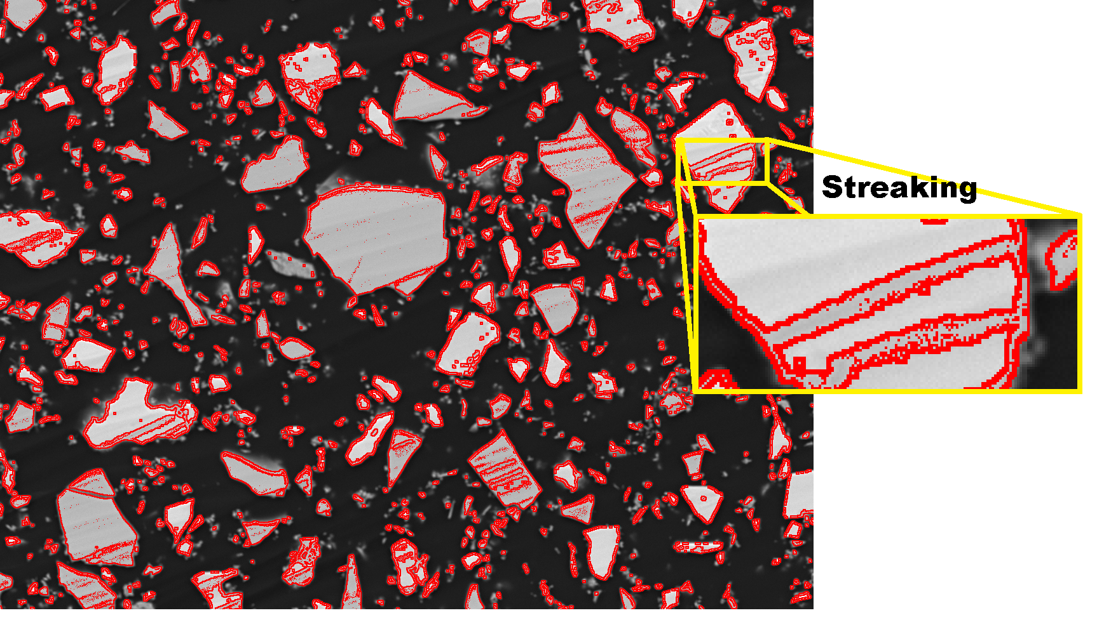
Naïve Grey Level Segmentation
Slag Area Identification Issues
Notes:
45

Slide 46
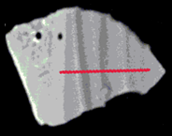
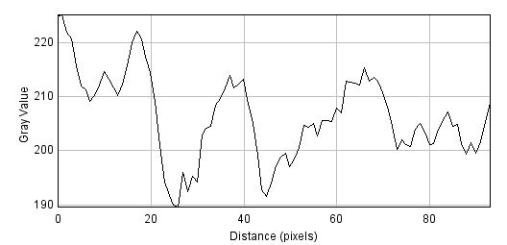
Streaking
Clinker Particle
Grey Level Range
190 – 230
Notes:
46

Slide 47
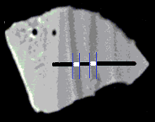
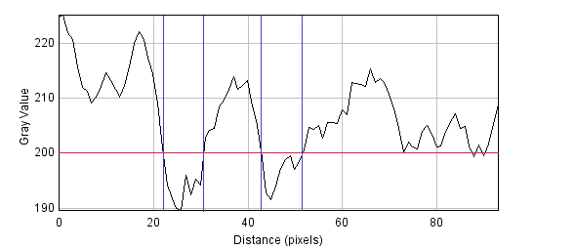
Streaking
Clinker Particle
Grey Level Range
190 – 230
Clinker
Slag
Notes:
47

Slide 48
Streaking
Arises from cross-section polishing imperfections
Many attempts with different settings, no success
Notes:
48

Slide 49
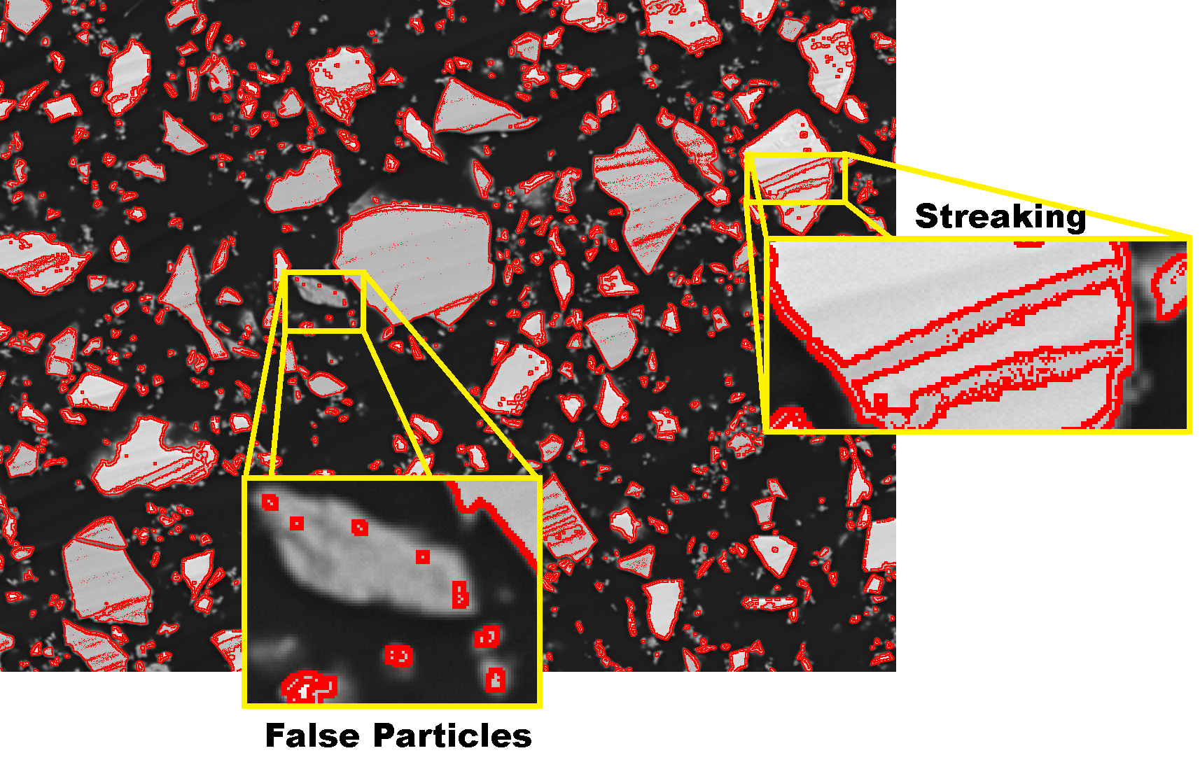
Naïve Grey Level Segmentation
Slag Area Identification Issues
Notes:
49

Slide 50
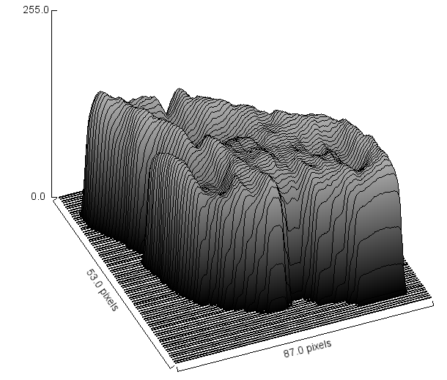

False Particles
Notes:
50

Slide 51
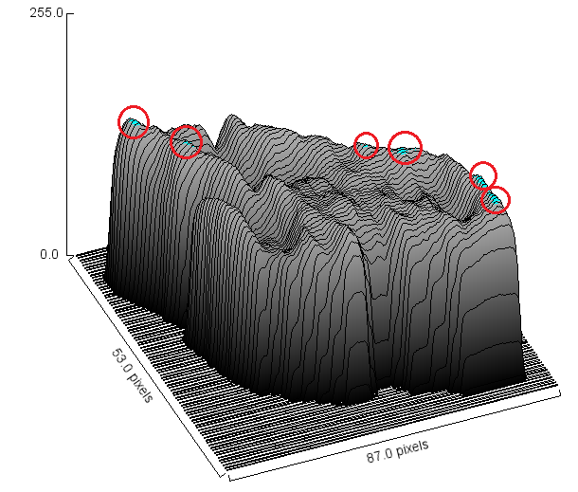
False Particles
Notes:
51

Slide 52
False Particles
Small effect on phase area percentage
Huge effect on particle size distribution
Large particles get split
Many small particles are created
Notes:
52

Slide 53
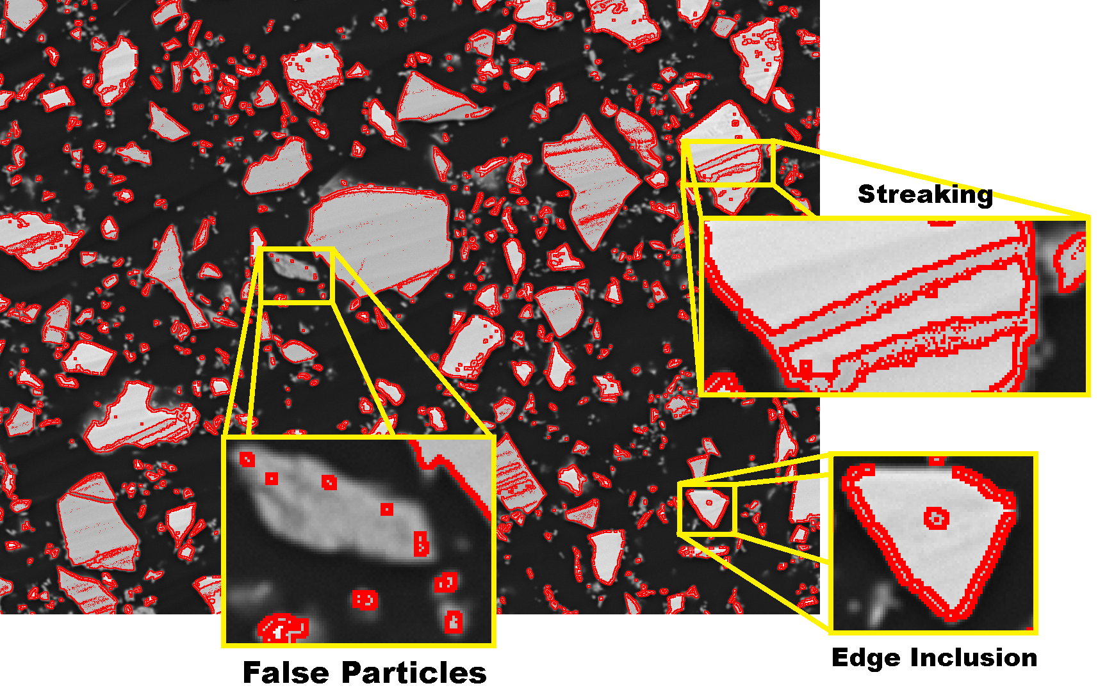
Naïve Grey Level Segmentation
Slag Area Identification Issues
Notes:
53

Slide 54
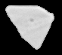
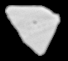
Edge Inclusion
 | Edge Removed | Edge Included
Average Grey Level | 209 | 199
Clinker-Slag Boundary = 200
Removing the edges makes classification easier and more accurate
Notes:
54

